Slide 1
Network centrality, inference and local computation
Devavrat Shah
LIDS+CSAIL+EECS+ORC
Massachusetts Institute of Technology
Notes:
<numéro>

Slide 2
Network centrality
It’s a graph score function
Given graph G=(V, E)
Assigns “scores” to nodes in the graph
That is,
F: G → R^{V}
A given network centrality or graph score function
Designed with aim of solving a certain task at hand
Notes:
<numéro>

Slide 3
Network centrality: example
Degree centrality
Given graph G=(V, E)
Score of node v is it’s degree
Useful for finding “how connected” each node is
For example, useful for “social clustering” [Parth.-Shah-Zaman ’14]
2
4
1
1
3
2
Notes:
<numéro>

Slide 4
Network centrality: example
Between-ness centrality
Given graph G=(V, E)
Score of node v is proportional to
Number of node pairs whose shortest path pass through it
Represents
“how critical” each node is to keep network connected
0
6.5
4
0
0.5
0
Notes:
<numéro>

Slide 5
Network centrality: example
PageRank centrality
Given di-graph G=(V, E)
Score of node v is equal to stationary distribution
Of a random walk on the directed graph G
Transition probability matrix of random walk (RW)
If RW at node i at a given time step, it will be at
Node j, with probability Q_{ij} where
If i has directed edge to j then Q_{ij} = (1-α)/d_{i} + α/n
Else Q_{ij} = α/n
Notes:
<numéro>

Slide 6
Network centrality: data processing
Data
(Networked)
Decision
Corpus of Webpages
PageRank
Search Relevant Content
Citation
Data
H-index
Scientific Importance
Why (or why not) does a given centrality make sense?
Notes:
<numéro>

Slide 7
Statistical data processing
Data
Statistical
Model
Decision
Example task: transmit a MSG bit B (= 0 or 1)
Tx : BBBBB
Rx : Each bit is flipped with probability p (=0.1)
At Rx, using received message, decide whether
Intended MSG is 0 or 1
ML estimation:
“Majority” Rule
Notes:
<numéro>

Slide 8
Statistical data processing
Data
Statistical
Model
Decision
Data to Decision
Posit model connecting data to decision (variables)
Learn the model
Subsequently make decisions
For example, solve a stochastic optimization problem
Notes:
<numéro>

Slide 9
This talk
Network centrality
Statistical view
For processing networked data
Graph score function = appropriate likelihood function
Explain this view through
Searching source of “information”/”infection” spread
Rumor centrality
Other examples in later talks
Rank centrality
Crowd centrality
Local computation
Stationary probability of a given node in a graph

Slide 10
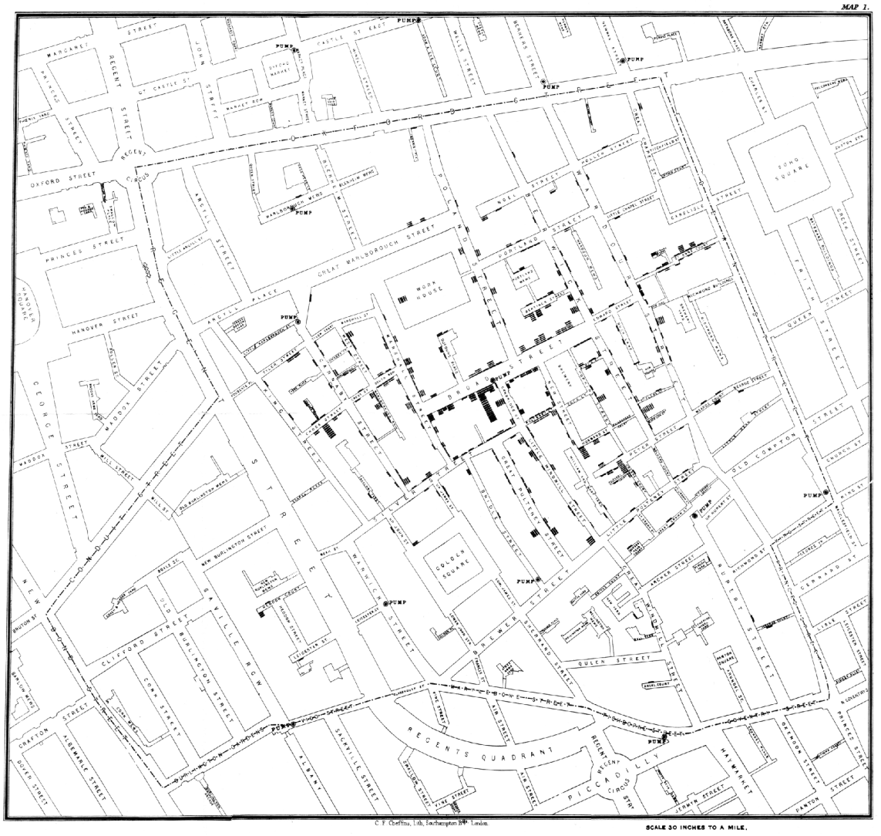
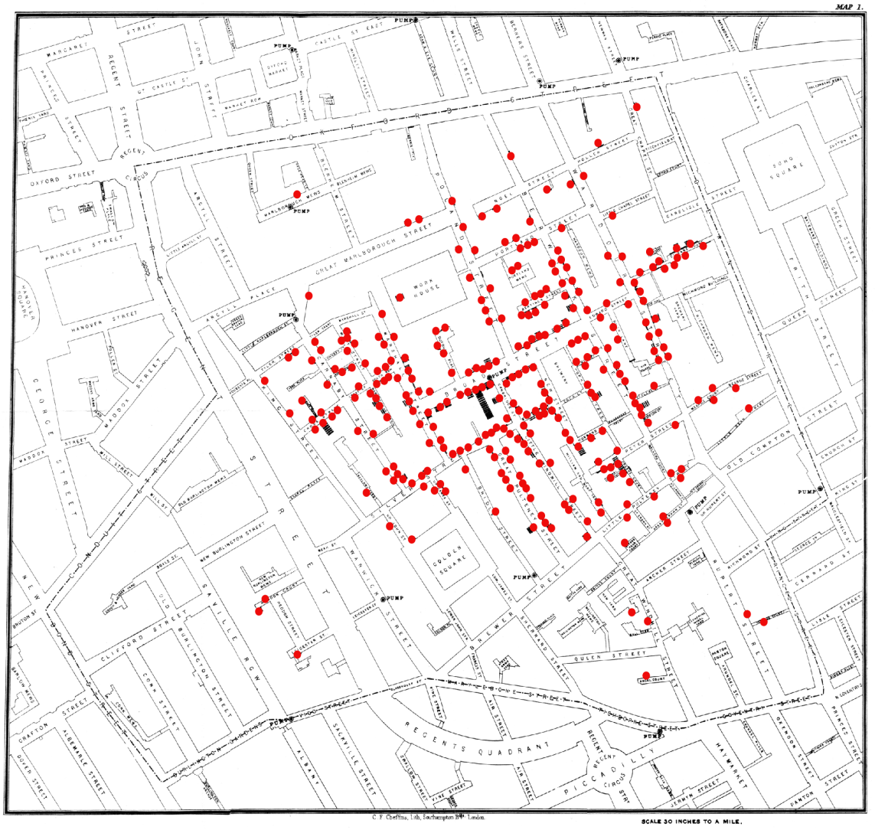
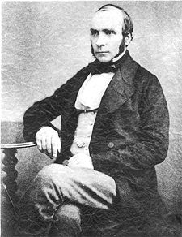
1854 London Cholera Epidemic
Cholera source
x
Center of mass
Dr. John Snow
Can we find the source in a network?
Notes:
John Snow is arguably father of Epidemiology. The germ theory, which identified
Specific bacteria, for example, being responsible for Cholera was only put forth in
1861. Before that, there was popular belief that Cholera was spread due to the
“air pollution”. Now the turning moment was the Cholera epidemic in London in 1854.
During this time, many people died in primarily Soho area. With help of local reverand,
Snow interviewed the family of deceased people. And identified commonality as
Almost all of them stayed near and used the water pump on the “broad(wick) street”.
Therefore, Snow concluded that the pump was responsible for this ill fate.
Here I am plotting points where deceased people were staying. And the pump as the
Cholera source.
There is further twist to this story: post fire, ev. body had cesspit underneath their
Homes. And one of the cesspit was leaking in the well of the water pump. It gets
More interesting: just before the outbreak, it seems nappies of baby with Cholera
(from other Source) were washed in that cesspit !
So that confirmed the doubt and led to water inspection and rest is the history.
Now: suppose we did not know reverend, nor possibly as thoughtful/resourceful, but
Have “network knowledge”. How would one find the source.
Well: here you find the Centre of Gravity !
<numéro>

Slide 11
Searching for source
Stuxnet (and Duqu) worm: who started it ?
Notes:
Stuxnet: a computer worm that spread in July 2010. It spreads in the network (P2P manner). It is
The so called rootkit which alters the “core” of the system and it has programmable logic, i.e. it can
Keep “innovating”. It aimed at affecting primarily industrial software and in particular certain types
Of Siemens equipment. There is little known “officially” but widely believed that it has put the nuclear
Program of “certain countries” behind by few years if not a decade : affecting the centrifuge of
Euranium enriching. It is brilliant ! Whichever side you are you would like to know either (a) who
is the likely source, or (b) can the likely source be detected ?
<numéro>

Slide 12
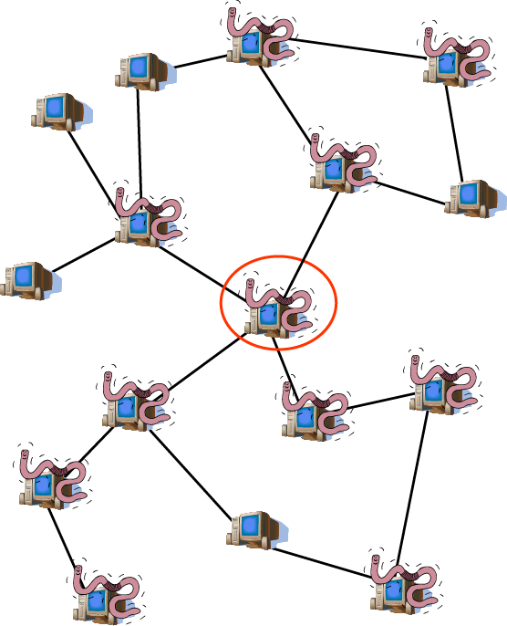
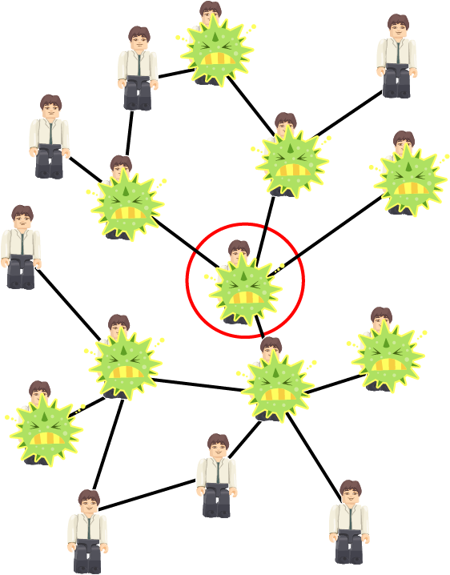
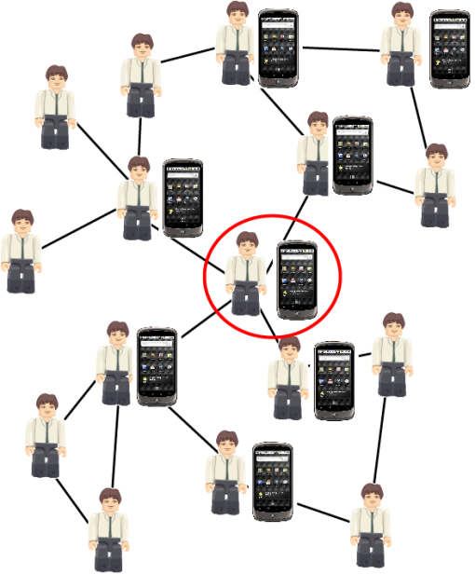

Searching for source
Cyber-attacks
Viral epidemics
Social trends
Notes:
<numéro>

Slide 13
Searching for source
Data
Statistical
Model
Decision
Infected Nodes,
Network
?
How Likely Each
Node as Source

Slide 14

Model: Susceptible Infected (SI)
Uniform probability of any node being source a priori
Spreading times on each edge are i.i.d random variables.
We will assume an exponential distribution (to develop intuition)
Results will hold for generic distribution (with no atom at 0)
Notes:
<numéro>

Slide 15
Rumor Source Estimator
We know the rumor graph G
We want to find the likelihood function:
P(G|source=v)
Not obvious how to calculate it
v
G
Notes:
<numéro>

Slide 16
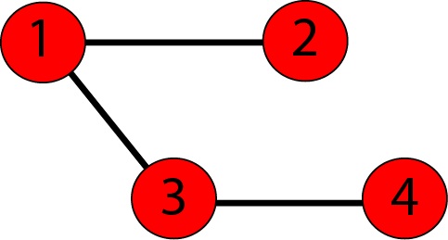
Rumor Spreading Order
Rumor spreading order not known
Only spreading constraints are available
1
2
3
4
2
1
3
4
1
3
2
4
1
3
4
2
More spreading orders = more likely to be source
Notes:
<numéro>

Slide 17
Regular Trees
Regularity of tree + memory-less property of exponential =
all spreading orders are equally likely
2
1
4
3
P(G|source=2) = P(2134|source=2) + P(2143|source=2)
= 2 * p(d=3,N=4)
New problem: counting spreading orders
Notes:
<numéro>

Slide 18
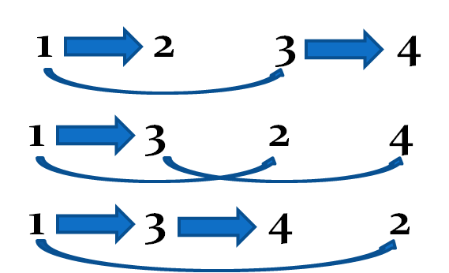
Counting Spreading Orders
R(v, G)= number of rumor spreading orders from v on G
N=Network size
T=Subtree size
1
2
3
4
Notes:
<numéro>

Slide 19
Rumor Centrality (Shah-Zaman, 2010)
The source estimator is a graph score function
It is the “right” score function for source detection
Likelihood function for regular trees
with exponential spreading times
Can be calculated in linear time

Slide 20









Rumor Centrality and Random Walk
1/7
3/7
5/7
3/7
5/7
1/7
Random walk with transition probability
Proportional to size of sub-trees
Stationary distribution =
Rumor Centrality
1/7
1/7
1/7
Stationary probability of visiting node ∝ Rumor Centrality

Slide 21

Rumor Centrality : General Network
Precisely, “next hop” info required under shortest path routing !
Rumor spreads on an underlying spanning tree of graph
Breadth-first search tree: “most likely” tree
Fast rumor spreading

Slide 22
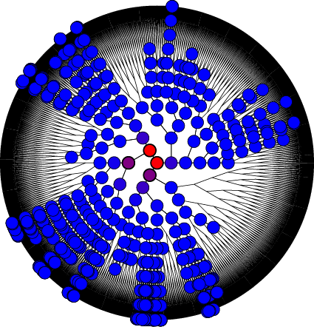

Precision of Rumor Centrality
Rumor centrality
(normalized)
1.0
True rumor source
0.8
0.6
0.4
0.2
0.0
Estimate of rumor source

Slide 23
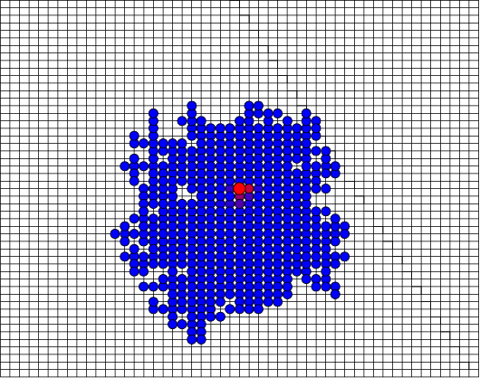
Precision of Rumor Centrality
Rumor centrality
(normalized)
1.0
True rumor source
0.8
0.6
0.4
0.2
Estimate of rumor source
0.0

Slide 24

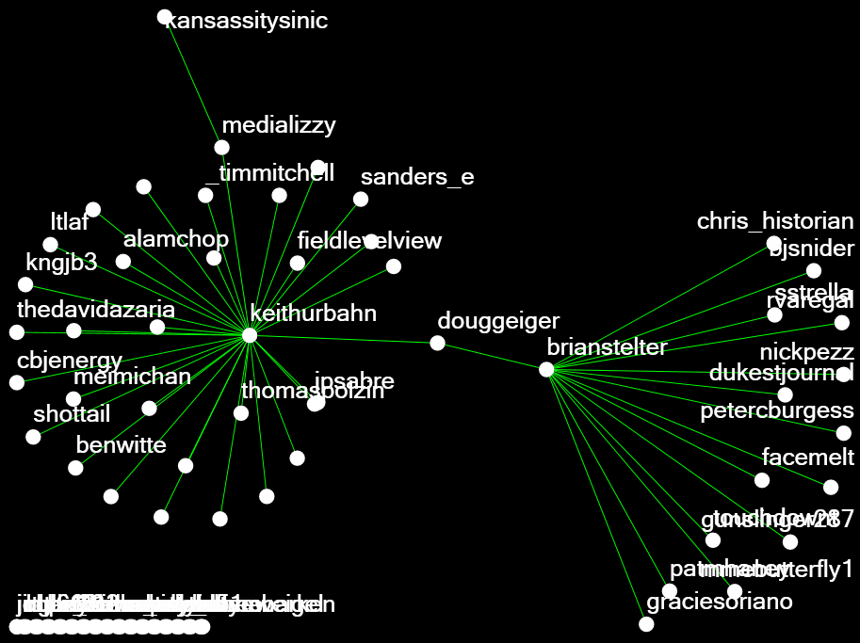
Bin Laden Death Twitter Network
Keith Urbahn: first to tweet about the death of Osama bin Laden
True rumor source
Estimate of rumor source

Slide 25
Effectiveness of rumor centrality
Simulations and examples show
Rumor centrality is useful to find “sources”
Next
When does it work
When it does not work
And, why

Slide 26
Source Estimation = Rumor Center
Rumor center v* has maximal rumor centrality
Rumor center
T^{v*}_{j}
V*
j
Network is “balanced”
around rumor center
If rumor spreads in a balanced manner:
Source = Rumor Center

Slide 27
Regular Trees (degree=2)
Balanced sub-trees
Proposition [Shah-Zaman, 2010]: Let a rumor spread for a time t on a regular tree with degree d=2 as per the SI model with exponential (or arbitrary) spreading time (with non-trivial variance). Then,
That is, line graphs are hopeless
What about a generic tree ?
Notes:
<numéro>

Slide 28
Some Useful Notation
Rumor spreads for time t to n(t) nodes
Let sequence of infected nodes be {v₁, v₂, …, v_{n(t)}}
v₁ = rumor source
C_{n(t)} = {rumor center is v_{k} after n(t) nodes are infected}
C_{n(t)} = correct detection
k
1
v₁
v₂
v₄
v₃

Slide 29
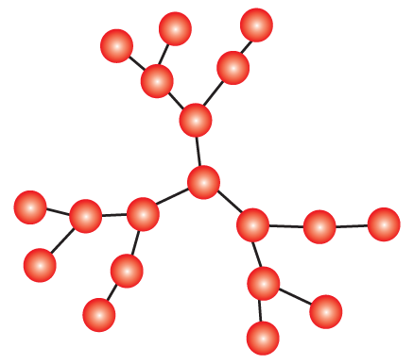
Result 1: Geometric Trees
Number of nodes distance l from any node grows as l^{α} (polynomial growth)
α=1
Proposition [Shah-Zaman, 2011]: Let a rumor spread for a time t on a (regular) geometric tree with α>0 from a source with degree > 2 as per the SI model with arbitrary spreading times (with exponential moments). Then
Notes:
<numéro>

Slide 30
Result 2: Regular Trees (degree>2)
Exponential growth
High variance “rumor graph”
Theorem [Shah-Zaman, 2011]: Let a rumor spread for a time t on a regular tree with degree d>2 as per the SI model with exponential spreading times. Then
where
and I_{x}(a,b) is the regularized incomplete Beta function:

Slide 31
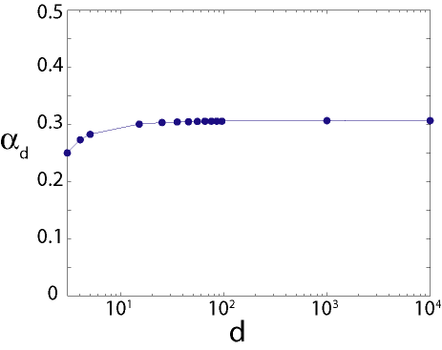
Result 2: Regular Trees (degree>2)
1-ln(2)
α₃ = 0.25

Slide 32
Result 2: Regular Trees (degree>2)
Theorem [Shah-Zaman, 2011]: Let a rumor spread for a time t on a regular tree with degree d>2 as per the SI model with exponential spreading times. Then

Slide 33
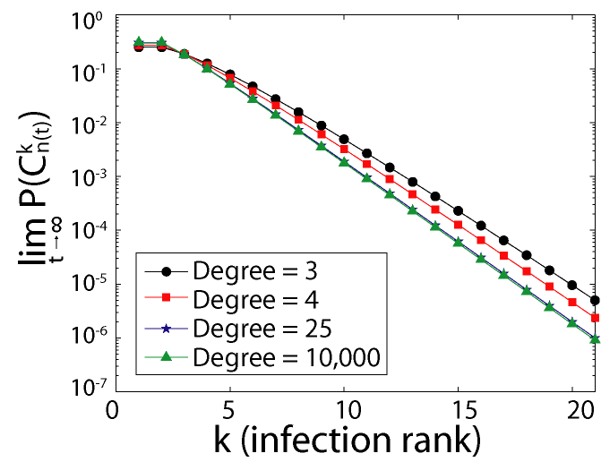
Result 2: Regular Trees (degree>2)
With “high probability” estimate is “close” to true source
Notes:
<numéro>

Slide 34
Result 3: Generic Random Trees
Start from root, each node i has η_{i} children (η_{i} are i.i.d.)
1
η₁=3
4
η₄=3
η₂=2
3
η₃=4
2
Theorem [Shah-Zaman, 2012]: : Let a rumor spread for a time t on a random tree with E[η_{i}]>1 and E[η_{i}²]< from a source with degree > 2 as per the SI model with arbitrary spreading times (non-atomic at 0). Then
8

Slide 35
Implication: Sparse random graphs
Random regular graph → regular tree
Erdos-Renyi graph → random tree
with η_{i} ~ Binomial distribution (Poisson in large limit)
Tree results extend

Slide 36
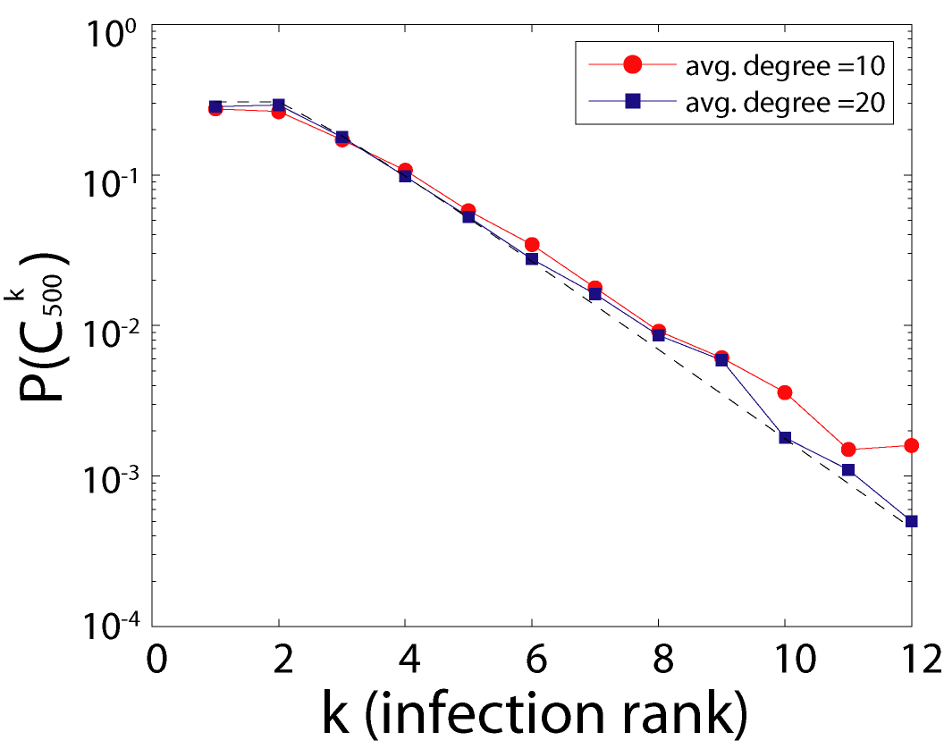
Erdos-Renyi Graphs
Graph has m nodes, each edge exists independently with probability p=c/m
Regular tree (degree = 10,000)

Slide 37
Proof Remarks

Slide 38
Incorrect Detection
T₂(t)
T₃(t)
V₁
T₁(t)
“Imbalance”

Slide 39
Evaluating
“Standard” approach:
Compute E[T_{l}(t)]
Show concentration of T_{l}(t) around its mean E[T_{l}(t)]
Use it to evaluate
P(T_{i}(t) > Σ T_{j}(t))
Issues
Variance in T_{l}(t) is of same order as mean
Hence, usual concentration is not useful
Even if it were
it would result in 0/1 style answer (which is unlikely)
T₂(t)
V₁
T₃(t)
T₁(t)

Slide 40
Evaluating
An alternative:
Understand ratio
T_{i}(t)/Σ T_{j}(t)
Characterize its limiting distribution
That is, T_{i}(t)/Σ T_{j}(t) → W
Use W to evaluate
P(T_{i}(t) > Σ T_{j}(t)) = P(W>0.5)
Goal:
How to find W ?
T₂(t)
V₁
T₃(t)
T₁(t)

Slide 41
Evaluating
Z’(t) =Z₂(t) +Z₃(t)= Rumor Boundary of T₂(t) +T₃(t)
T₂(t)+T₃(t)
Initially
T₁(0)=0
T₂(0) + T₃(0)=0
Z₁(0) = 1
Z₂(0)+Z₃(0) = 2
V₁
First infection
T₁(.)=1
T₂(.) + T₃(.)=0
Z₁(.) = 2
Z₂(0)+Z₃(0) = 2
Second infection
T₁(.)=1
T₂(.) + T₃(.)=1
Z₁(.) = 2
Z₂(0)+Z₃(0) = 3
In summary
Z₁(t)= T₁(t)+1
Z₂(t)+Z₃(t) = T₂(t) + T₃(t) +2
Therefore, for large t
T₁(t)/(T₂(t) + T₃(t)) equals Z₁(t)/(Z₂(t) + Z₃(t))
Therefore, track ratio of boundaries
T₁(t)
Z₁(t)= Rumor
Boundary of T₁(t)
Notes:
Consider the sub-tree growth : for example, there are subtrees and their boundaries. For regular tree with d > 2 or generic tree, each of the tree size grows exponentially in t. Therefore, boundary nodes are also of the same order as the tree size itself. First attempt to bound above is to obtain concentration around mean and then clearly find out about the “separation”. But each of these have very high variance and of the same order as the size of the tree. Therefore, concentration results will suggest that each of the sizes are in the “variance” uncertainty region of each other and hence not clear if provide any meaningful answer. Further, the average value of tree size is very “time sensitive” with v. high variances.
<numéro>

Slide 42
Evaluating
Boundary evolution
Two types: Z₁(t) and Z’(t)
Each new infection increases
Z₁(t) or Z’(t) by +1
Selection of Z₁(t) vs Z’(t):
Z₁(t) with prob. Z₁(t)/(Z₁(t) + Z’(t))
Z’(t) with prob. Z’(t)/(Z₁(t) + Z’(t))
This is exactly Polya’s Urn
With two types of balls
Z’(t) =Z₂(t) +Z₃(t)= Rumor Boundary of T₂(t) +T₃(t)
T₂(t)+T₃(t)
V₁
T₁(t)
Z₁(t)= Rumor
Boundary of T₁(t)
Notes:
Consider the sub-tree growth : for example, there are subtrees and their boundaries. For regular tree with d > 2 or generic tree, each of the tree size grows exponentially in t. Therefore, boundary nodes are also of the same order as the tree size itself. First attempt to bound above is to obtain concentration around mean and then clearly find out about the “separation”. But each of these have very high variance and of the same order as the size of the tree. Therefore, concentration results will suggest that each of the sizes are in the “variance” uncertainty region of each other and hence not clear if provide any meaningful answer. Further, the average value of tree size is very “time sensitive” with v. high variances.
<numéro>

Slide 43
Evaluating
Boundary evolution = Polya’s Urn
M(t) = Z₁(t)/(Z₁(t) + Z’(t))
Converges almost surely to a r.v. W
Goal:
P(T₁ (t) > (T₂(t) + T₃(t))) = P(W > 0.5)
W has Beta(1,2) distribution
Z’(t) =Z₂(t) +Z₃(t)= Rumor Boundary of T₂(t) +T₃(t)
T₂(t)+T₃(t)
V₁
T₁(t)
Z₁(t)= Rumor
Boundary of T₁(t)
Notes:
Consider the sub-tree growth : for example, there are subtrees and their boundaries. For regular tree with d > 2 or generic tree, each of the tree size grows exponentially in t. Therefore, boundary nodes are also of the same order as the tree size itself. First attempt to bound above is to obtain concentration around mean and then clearly find out about the “separation”. But each of these have very high variance and of the same order as the size of the tree. Therefore, concentration results will suggest that each of the sizes are in the “variance” uncertainty region of each other and hence not clear if provide any meaningful answer. Further, the average value of tree size is very “time sensitive” with v. high variances.
<numéro>

Slide 44
Probability of correct detection
For generic d-regular tree
The corresponding W is Beta(1/(d-2), (d-1)/(d-2))
Therefore
Where (with β_{d} =1/(d-2))

Slide 45
Generic Trees: Branching Process
V₁
T₁(t)= Subtree
Z(t)= Rumor boundary
(branching process)
Lemma (Shah-Zaman ‘12): For large t, Z(t) proportional to T₁(t).
T₁(t) Z(t)
Z(0)=1
T₂(t)+…+T_{k}(t) Z’(t)
Z’(0)=k-1

Slide 46
Branching Process Convergence
Following result known for branching processes (cf. Athreya-Ney ‘67)
α is the “Malthusian parameter”
depends on distribution of spreading time and node degree
W is a non-degenerate RV with absolutely continuous distribution
For regular tree, exponential spreading times, W has a Beta distribution

Slide 47
Summary, thus far
Rumor source detection
Useful Graph Score Function: Rumor centrality
Exact likelihood function for certain networks
Can be computed quickly (e.g. using linear iterative algorithm)
Effectiveness
Accurately finds source on essentially
any tree or sparse random graph
any spreading time distribution
What else can it be useful for?
Thesis of Zaman – Twitter Search Engine
Bhamidi, Steele and Zaman ‘13

Slide 48
Computing centrality
Computing centrality is equal to finding
Stationary distribution of random walk on network
For a reasonably many settings, including
PageRank
Rumor centrality
Rank centrality
…
Well, that should be easy

Slide 49
Computing stationary distribution
Power iteration method [cf. Golub-Loan ’96]
It primarily requires centralized computation
Iteratively multiply matrix and vector
100Gb of RAM will limit matrix size to ~100k
But, a social network can be more than a million
And, web is much larger
So, it’s not that easy

Slide 50
Computing stationary distribution
PageRank specific “local” computation solution
A collection of clever, powerful solutions
Jeh et.al. 2003, Fogaras et.al. 2005, Avrachenkov et.al. 2007, Bahmani et.al. 2010, Borgs et al 2012
Rely on the fact that
From each node, transition to any other node happens
With probability greater or equal to a known fixed positive constant (α/n)
Do not extend for any random walk or countably infinite graphs

Slide 51
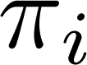
Markov chain, Stationary distribution
Random walk or Markov chain
(unknown) finite size or countably infinite size state space
Each node/state can execute next step of Markov chain
Jump from state i to j with probability P_{ij}
Irreducible, aperiodic
It means that there is a well defined, unique stationary distribution π
Goal: for any given node i, obtain estimation of
By accessing only “local” neighborhood of node i

Slide 52
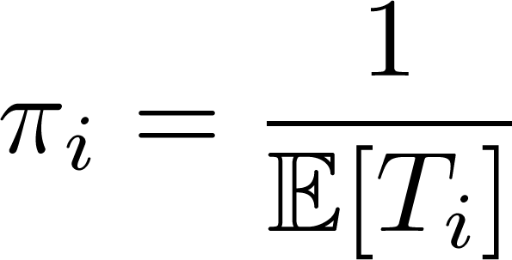
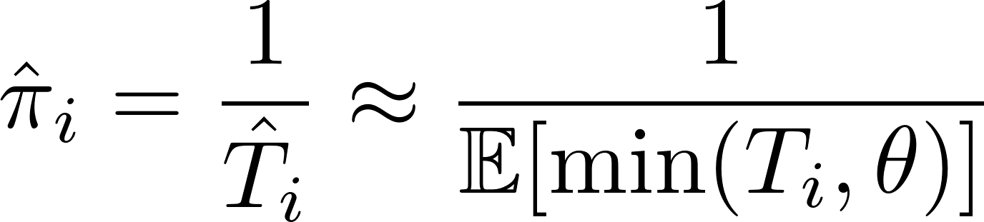
Key property
True value:
expected return time
Estimate:
average truncated return time

Slide 53
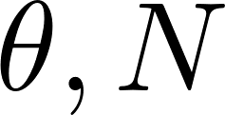
Algorithm
Input: Markov chain (Σ, P) and node i
Parameters:
Gather Samples
Terminate if Satisfied
Update and Repeat

Slide 54

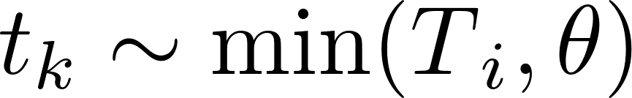
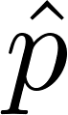
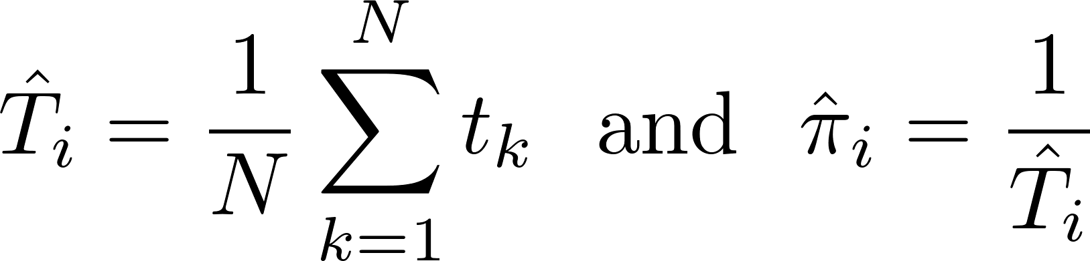
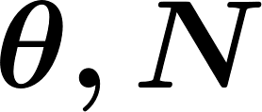
Algorithm
Gather Samples
Sample truncated return paths:
= fraction of samples truncated
Terminate if Satisfied
Update and Repeat

Slide 55
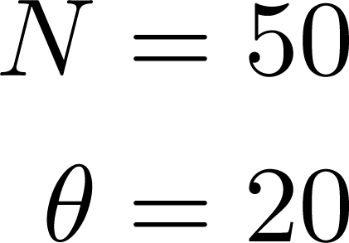
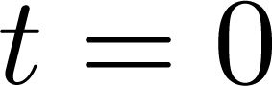
i
<numéro>
Notes:
<numéro>

Slide 56
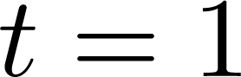
i
<numéro>
Notes:
<numéro>

Slide 57
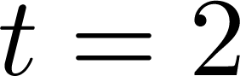
i
<numéro>
Notes:
<numéro>

Slide 58
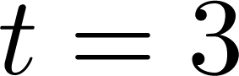
i
<numéro>
Notes:
<numéro>

Slide 59
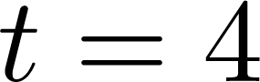
i
<numéro>
Notes:
<numéro>

Slide 60

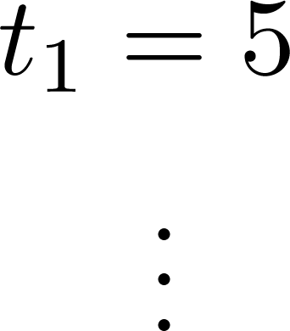
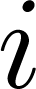
i
Returned to !
<numéro>
Notes:
<numéro>

Slide 61
i
<numéro>
Notes:
<numéro>

Slide 62
i
<numéro>
Notes:
<numéro>

Slide 63
i
Keep walking …
<numéro>
Notes:
<numéro>

Slide 64

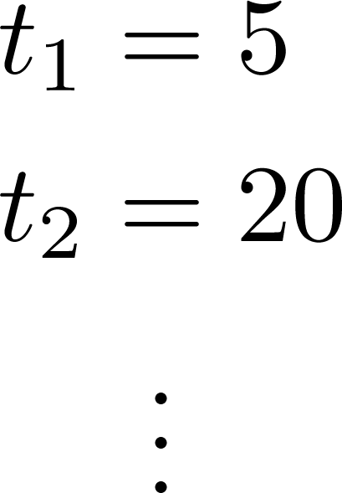

i
Path length exceeded
<numéro>
Notes:
<numéro>

Slide 65
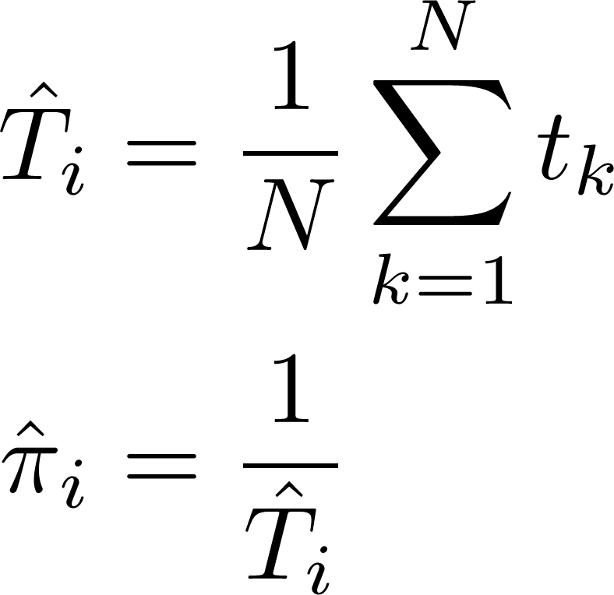
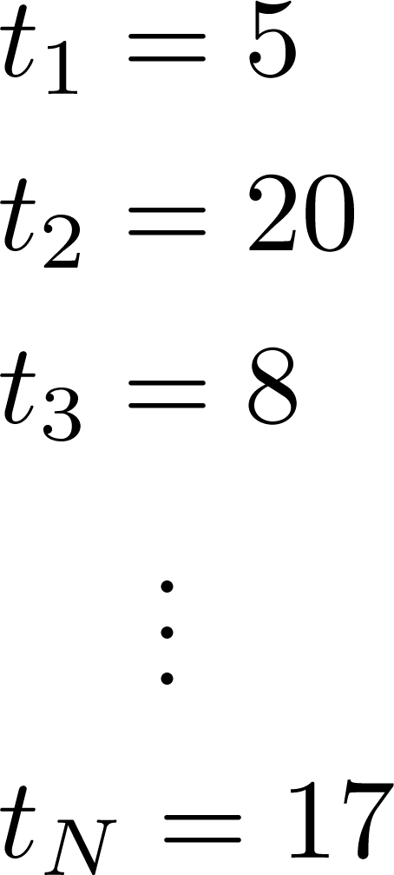
i
<numéro>
Notes:
The key idea of our algorithm is to use trunctation, however we can see that it is a tradeoff. By truncating the walk, we lose information about how much longer this sampled return time would have been, yet on the other hand, we also save computation time.
In the following slides we will analyze the effect of truncation on the estimate for different nodes.
<numéro>

Slide 66


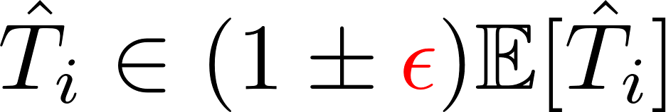
Algorithm
Gather Samples
Terminate if Satisfied
Update and Repeat
Double and increase such that
with probability greater than ,
confidence
closeness of estimate

Slide 67
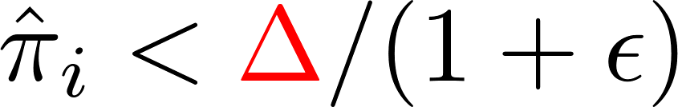
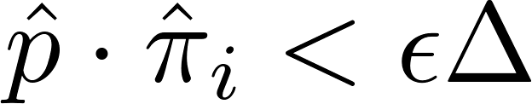
Algorithm
Gather Samples
Terminate if Satisfied
Terminate and output current estimate if
(a) Node is unimportant enough (b) Fraction of truncated samples is small
Update and Repeat
threshold for
importance

Slide 68
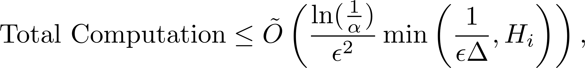
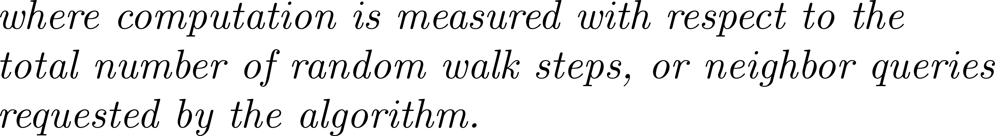
Local Computation [Lee-Ozd-Shah ’13]

Slide 69
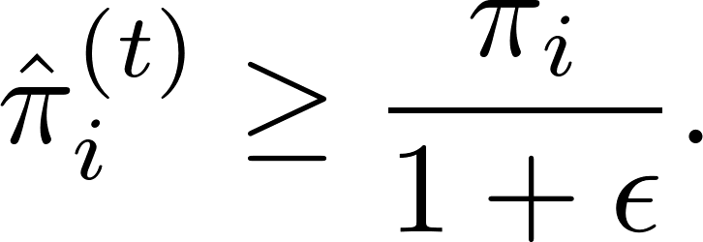
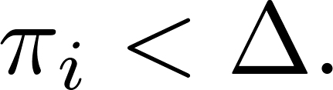
Correctness: under (a) [Lee-Ozd-Shah ’13]

Slide 70
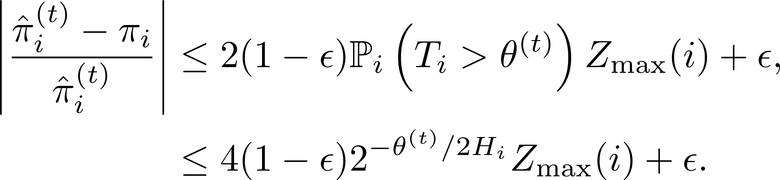
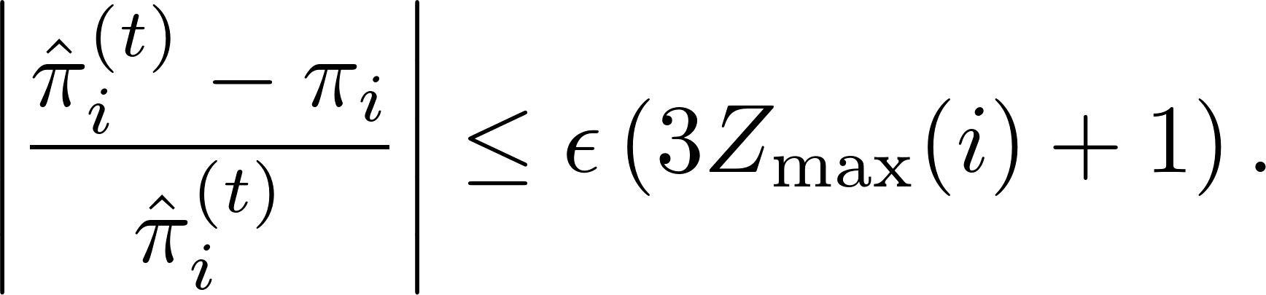
Correctness: under (b) [Lee-Ozd-Shah ’13]

Slide 71
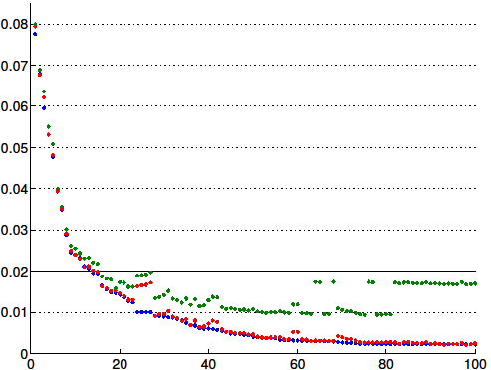
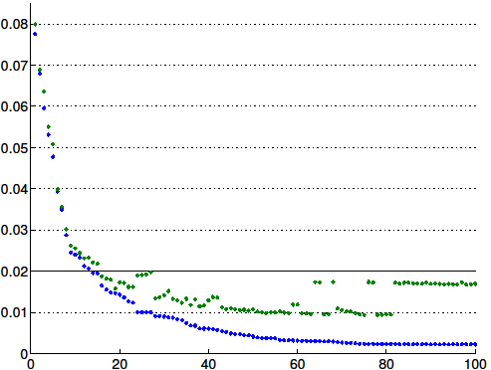
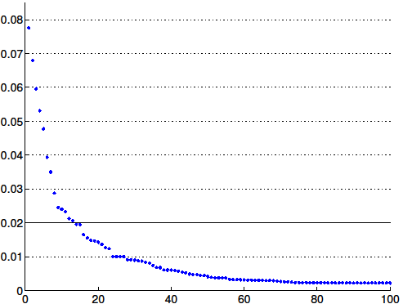
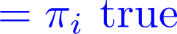
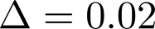
Simulation: PageRank
Stationary
probability
Random graph using configuration model
and power law degree distribution
Nodes sorted by stationary probability

Slide 72
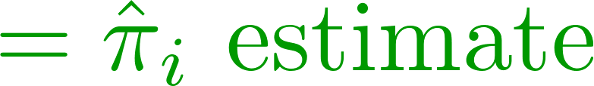
Simulation: PageRank
Obtain close estimates for important nodes
Stationary
probability
Nodes sorted by stationary probability

Slide 73
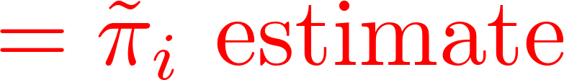

Simulation: PageRank
Stationary
probability
corrects for the bias!
Nodes sorted by stationary probability

Slide 74


Bias Correction
True value:
Estimate:
Fraction samples not truncated

Slide 75
Summary
Network centrality
Useful tool for data processing
A principled approach
Graph score function = Likelihood function
An example: Rumor centrality
Accurate source detection
Local Computation
Stationary distribution of Markov chain/Random walk

